Slide 1
Interactiv Coloring Book
Group Members:
Johannes Scheibe
Thilo von Glan
Jill Baumann

Slide 2
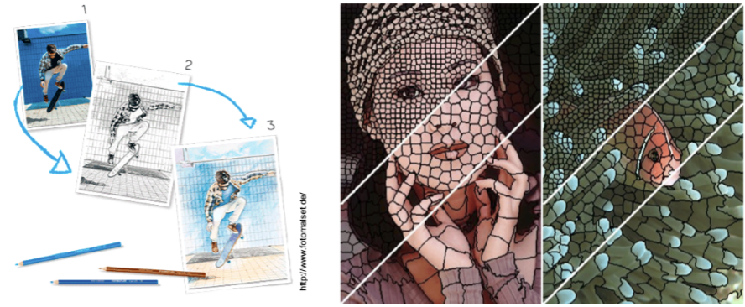
Main goal "Create a coloring template out of a photo"

Slide 3
Step 1: Make and/or select images and load these images
Handle color space (from BGR to RGB or CIELAB)

Slide 4
Step 2: Segmentate the image into sensible parts/regions/segments
Different methods possible
Manually choose each region
Define the number of regions manually
Recognize regions automatically, based on color differences
Opportunity to change parameters
Algorithms
Preprocessing
apply different filters to support the edge detection
Monochrome picture
Smooth the image (Gaussian filter)
Contrast adjustment
Edge detection
Brightness variation between bordering pixels -> Edge
Image segmentation
Region growing
Based on colors ((SLIC)Superpixels)

Slide 5
Step 3: Make the boarder of each segment clearly visible (without colors)
Step 4: Provide colors and prepare the picture for repainting
Color detection
Define a set of colors
Assign colors from the predefined set to the regions based on their (average) color
Replace colors with appropiate, predefined numbers

Slide 6
Step 4: Create User Interface
Upload the picture
Download the result
Adjust settings to get different results

